Slide 1

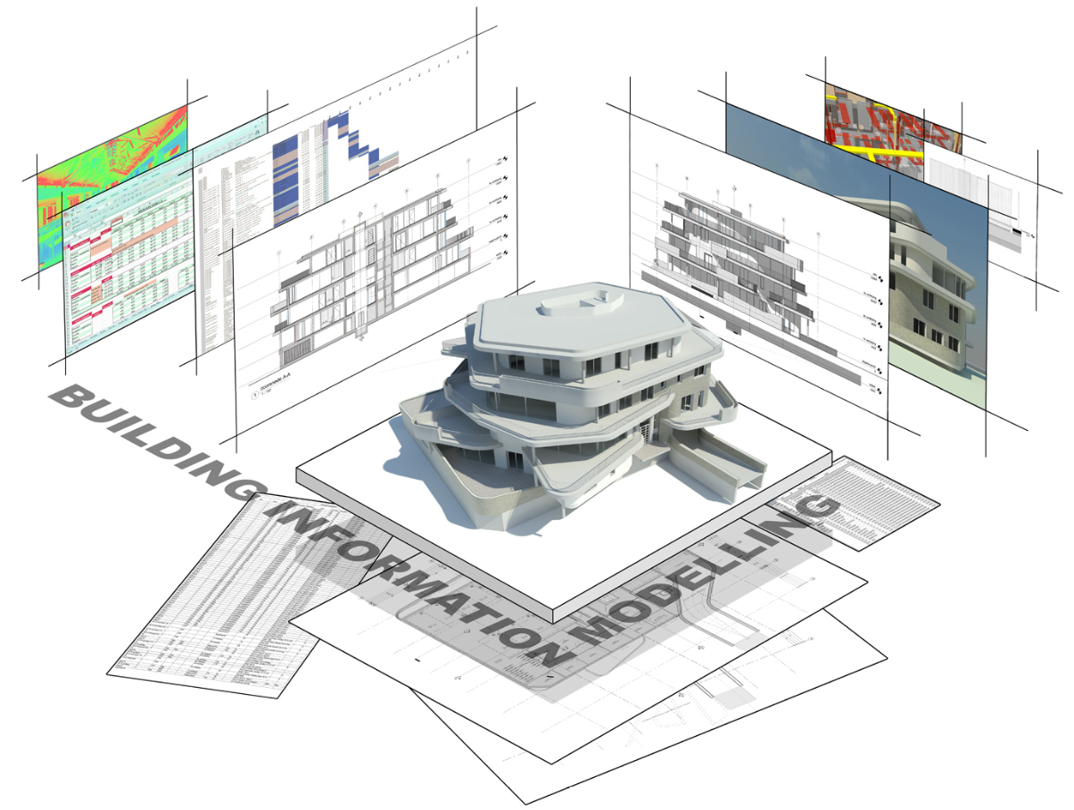
Responsive
Collaborative
Innovative
Integrity
Quality
“Innovative Design approach through the implementation of BIM"
… Team VDEC
www.vdengg.com
info@vdengg.com
Tel : +91-40-23327160, +91-8106436603; Fax:+91 40-23327151
Virtual Design Engineering Consultants
Sanman PMR, Flat No 502, Fifth Floor Saifabad, Hyderabad, Telangana 500004 Hydearabad, India.

Slide 2
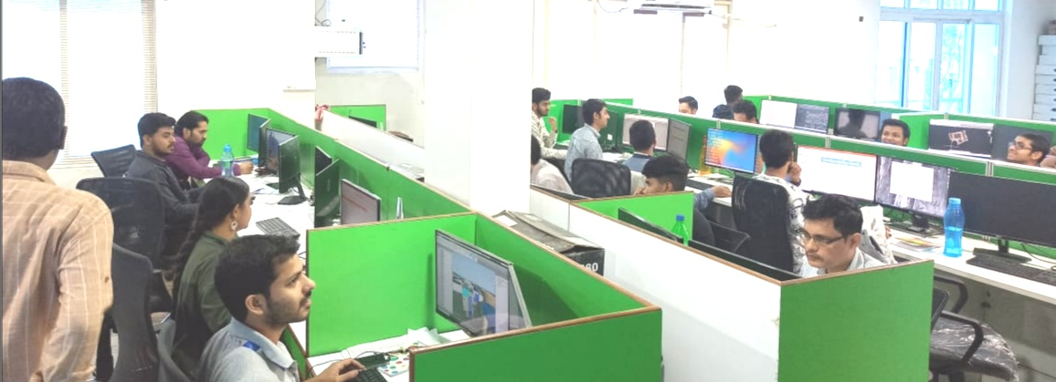
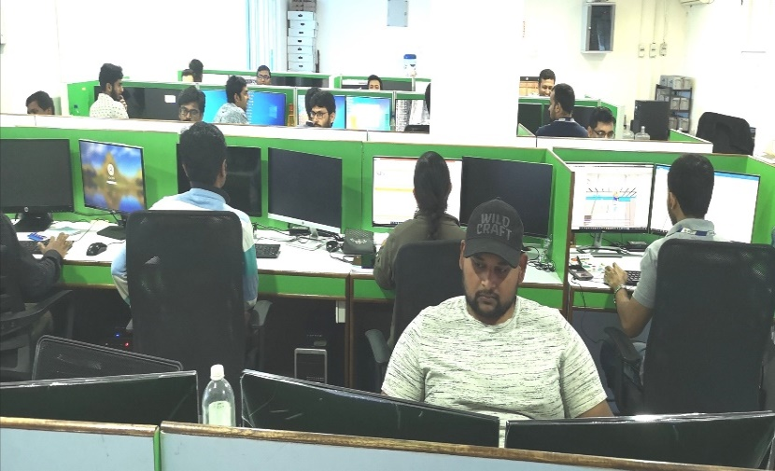
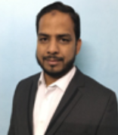
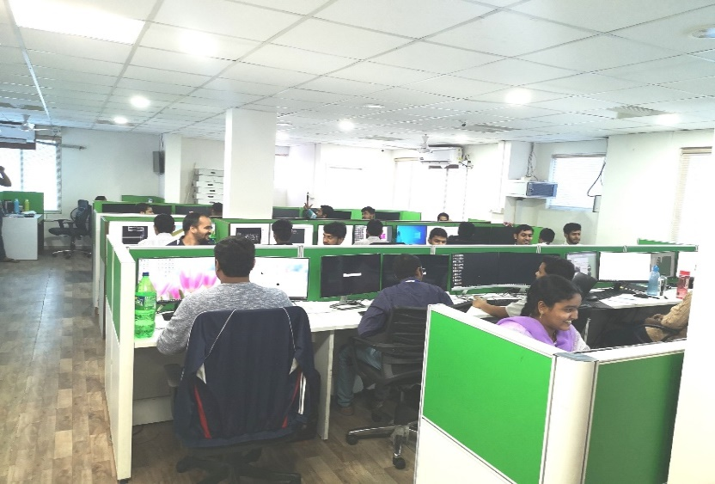
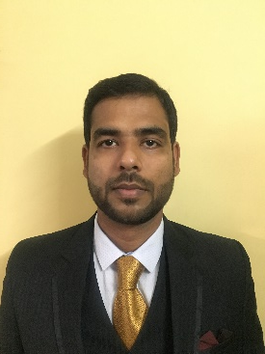
About us
We believe that we can bring a change in how buildings are conceived, designed, built and operated with the implementation of BIM.
Since our inception, we have been helping various clients in delivering value added BIM services in the AEC industry.
Mohammed Nadeem Khan, CEO & Founder. Nadeem has over 21 years’ experience in design, quality control & project management (MEPF Services). His area of speciality is HVAC design. He leads multidisciplinary teams on developing newer and more efficient workflows. Using his creative inputs he manages the design department at VDEC. Also leading the Business Development efforts for the firm.
Company At A Glance
50+ On-going Clients
200+ Projects Across the Globe
7 Years of Operation
Two Offices in India
Team of 45+ BIM Professionals
Professionals Experience
  Gulf (8 to 18 ) Years
  USA (5 to 10) Years
  Europe (6 to 10 ) Years
  India (5 to 8) Years
Mohammed Abubacker Siddiq, CFO & Founder. Abu backer has over 13 years of experience in designing electrical power, lighting, communication, and ﬁre alarm systems for all type of public / private applications. He looks after the financial aspects of VDEC along with IT security while also involving himself in technical projects related to construction management.

Slide 3


Service offerings
Quantity Take-offs
Quantities are extracted from a fully developed 3D BIM model.
3D BIM Modelling
Scan to BIM
3D Models are developed for Architecture, Structure & MEP trades from PDF & CAD inputs.
Shops/Installation, Spool, CAM, Trimble, Equip PAD, Sleeve & Riser drawings
The point cloud data from Laser Scans are developed into a 3D model.
BIM Consulting
Assist firms in implementing BIM by supporting them in developing BIM Standards, templates and content creation process.
4D/ 5D Sequencing
Clash Detection & Coordination
The 4th dimension time and 5 dimension cost will be added to the fully developed 3D BIM model for construction scheduling & cost analysis.
2D Design drawings are developed into a 3D BIM Model for constructability review and clash detection.
Other Verticals
Dynamo scripting
Cobie data/Asset management
AR/VR, Lumion & 3Ds Max
3D as-built documentation
3D As-built model & documentation will be updated from Red-line mark-ups received from site team.

Slide 4
Confidence of our workforce in the actions of our company. While this may include confidence in managers /individual team members, it also extends to organizational factors like: The company's mission. Senior leadership's vision. The organization's culture and values.
Trust
We are 20-30% economical in the Outsourcing Industry
what differentiates us?
Our team has met the Project Schedule on 95% of our projects
16/7
Working Culture
(Two Shifts
6Am to 2Pm and
2Pm to 10PM)
Concentrates on quality control and organization of resources so as to meet the objectives of the business on a global perspective.
Global Management
We believe in having an Engineering Mindset
Quality is in our DNA
Putting our best foot forward every day to ensure the success of the organization.
We are Adaptable to Technology Advances
95% of Repeat Clients
Outlines the company's relationship with and approach to our employees. Organization plans to utilize its employees to achieve its objectives.
People Strategy

Slide 5
Our project workflow
PLANNING FOR PROJECT KICK_OFF MEETING
Our estimation workflow
Input study & additional required documents checklist
PROJECT KICK-OFF MEETING
Resource Introduction
INTERNAL PLANNING
Responsibility Allotment
Project Mastery
Schedule Finalization
Set Milestone
Set Milestone
Daily Worklog
WORK BEGINS
Weekly Meetings
Review Reports
RFIs
QA/QC Process
INPUT STUDY
LOD |
SCHEDULE |
DELIVERABLES |
BUILT UP AREA (BUA) |
COMPLEXITY OF WORK |
NUMBER OF SHEETS |
MAN-HOURS ESTIMATION
QUOTE/COSTING
MILESTONE CALCULATION

Slide 6
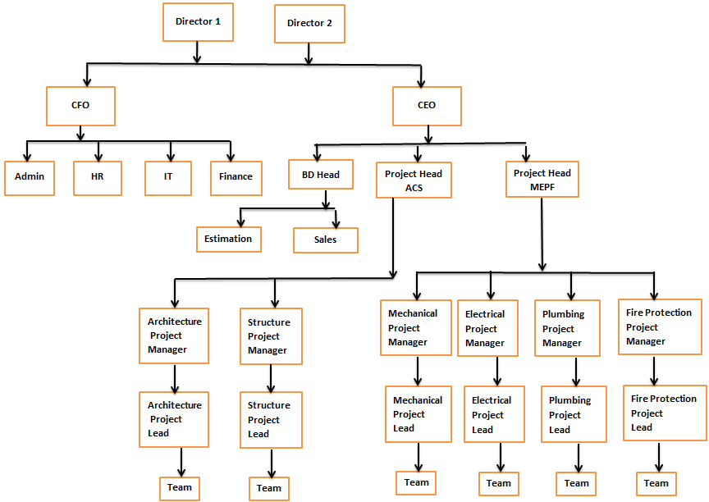
Organization chart

Slide 7
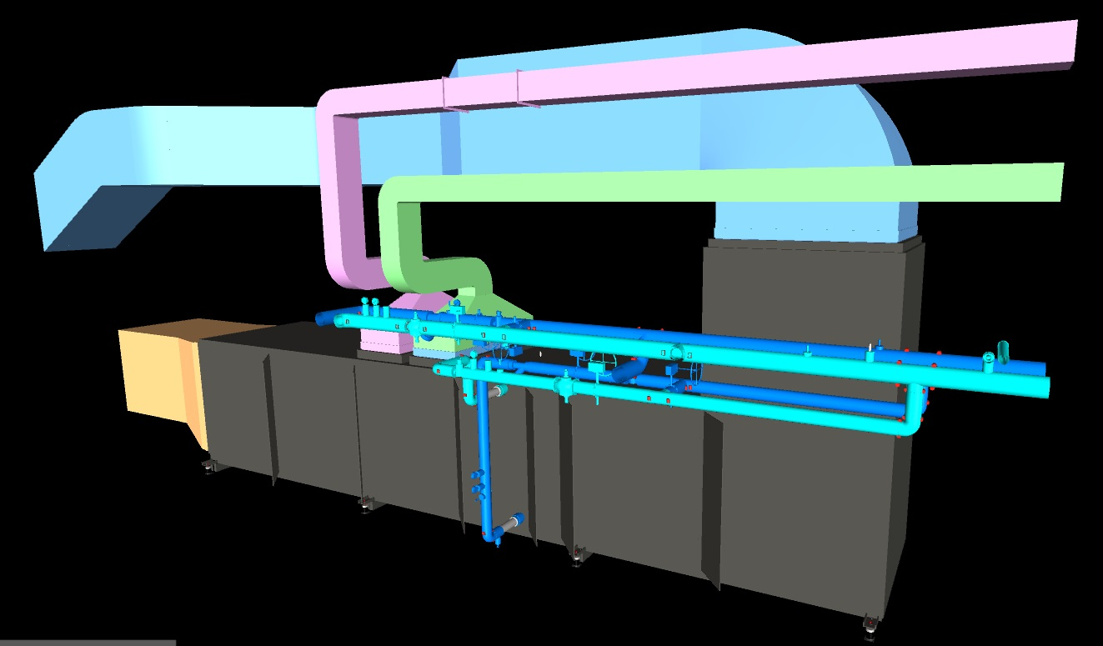
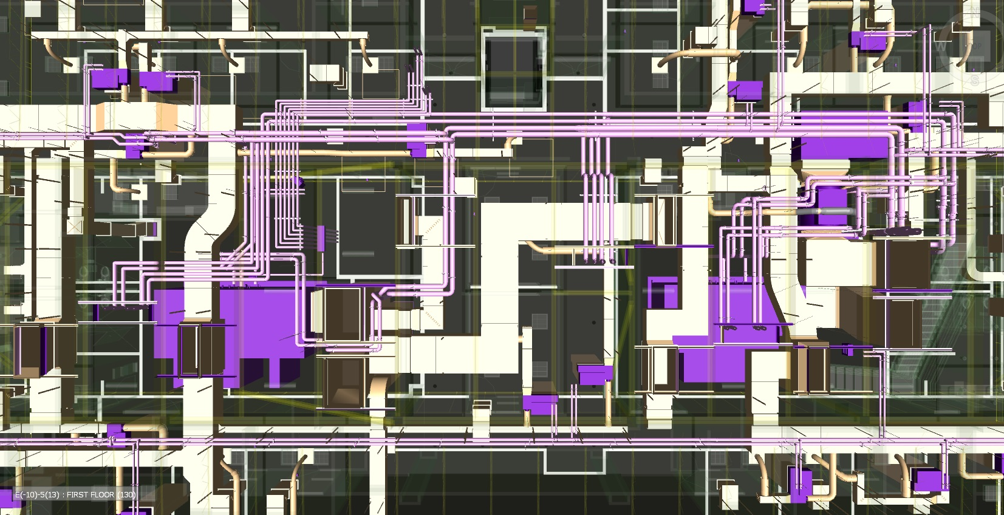
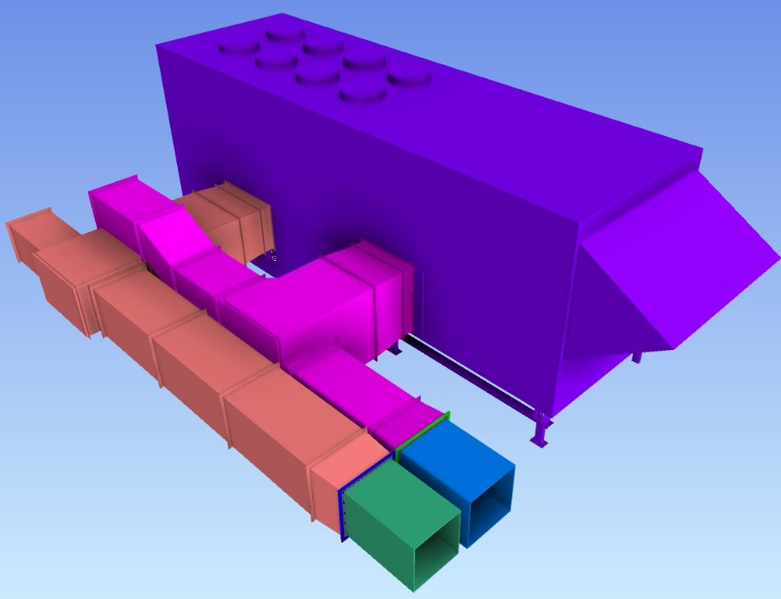
HVAC Model
HVAC system is modelled based on SMACNA & DW144 standards.
We provide the Shop /Installation drawings as such they are sufficient for workshop fabrication as well as on-site installation.
We can generate accurate sleeve, penetration and hanger locations from the HVAC model prior to the start of HVAC installation.

Slide 8
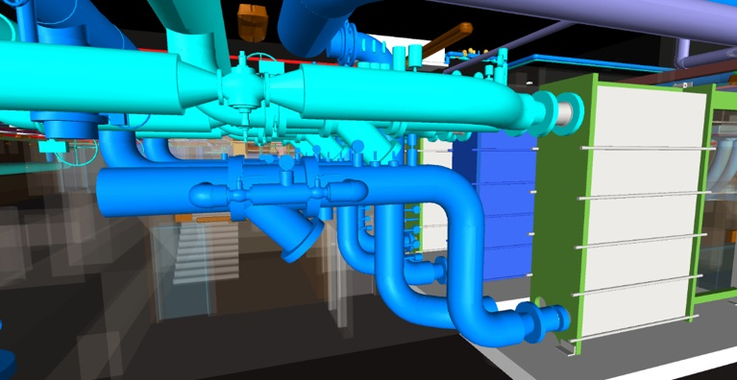
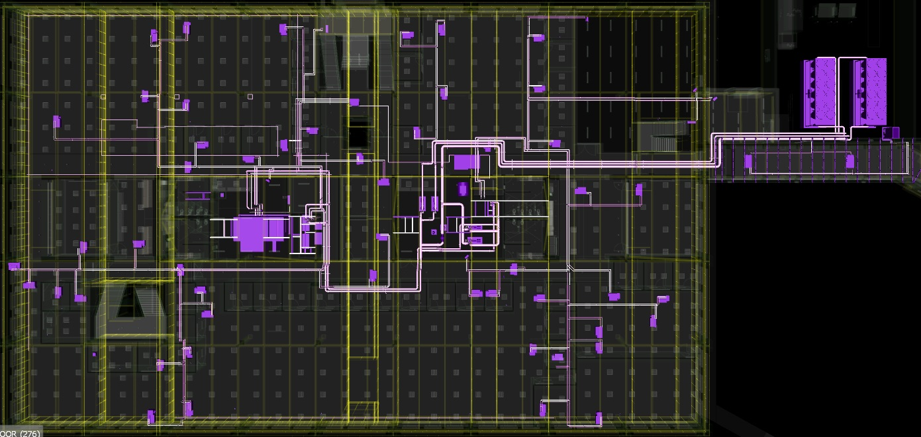
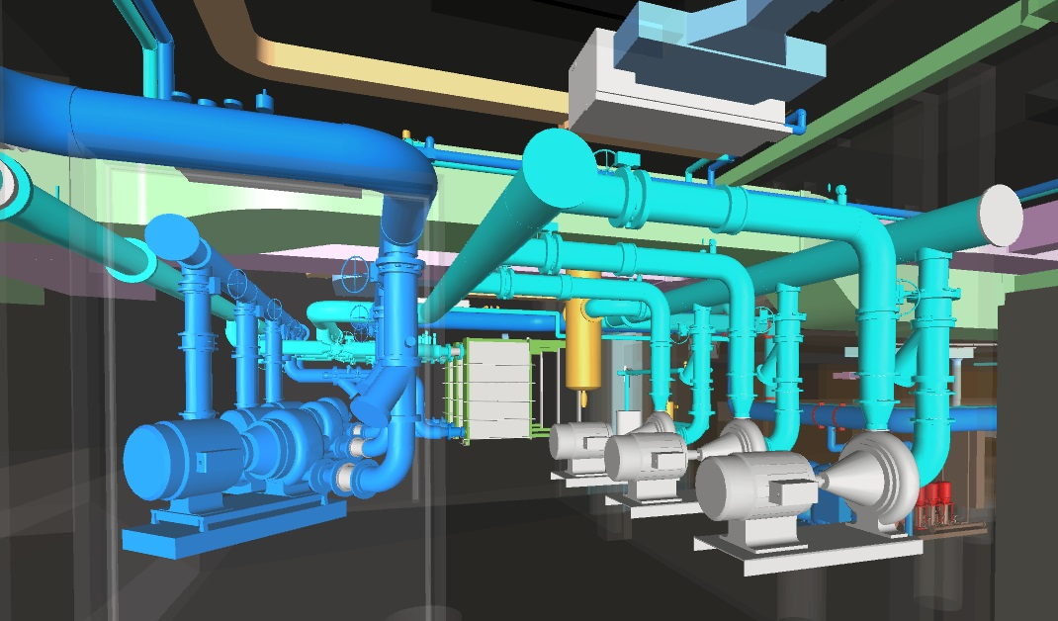
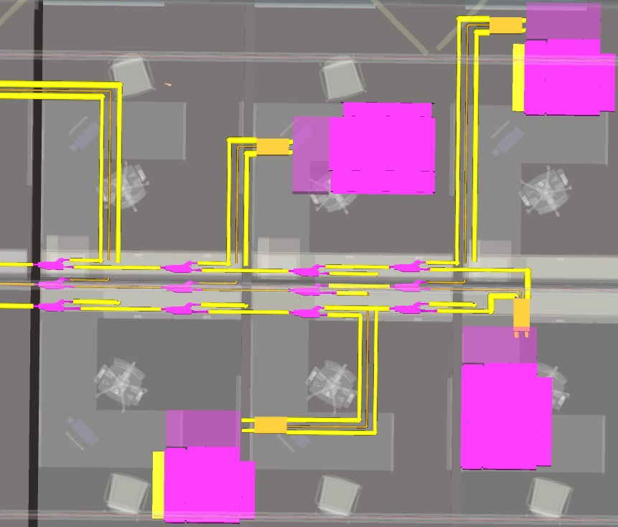
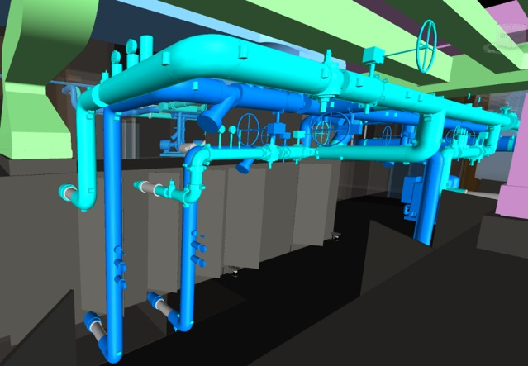
Mechanical Piping Model

Slide 9
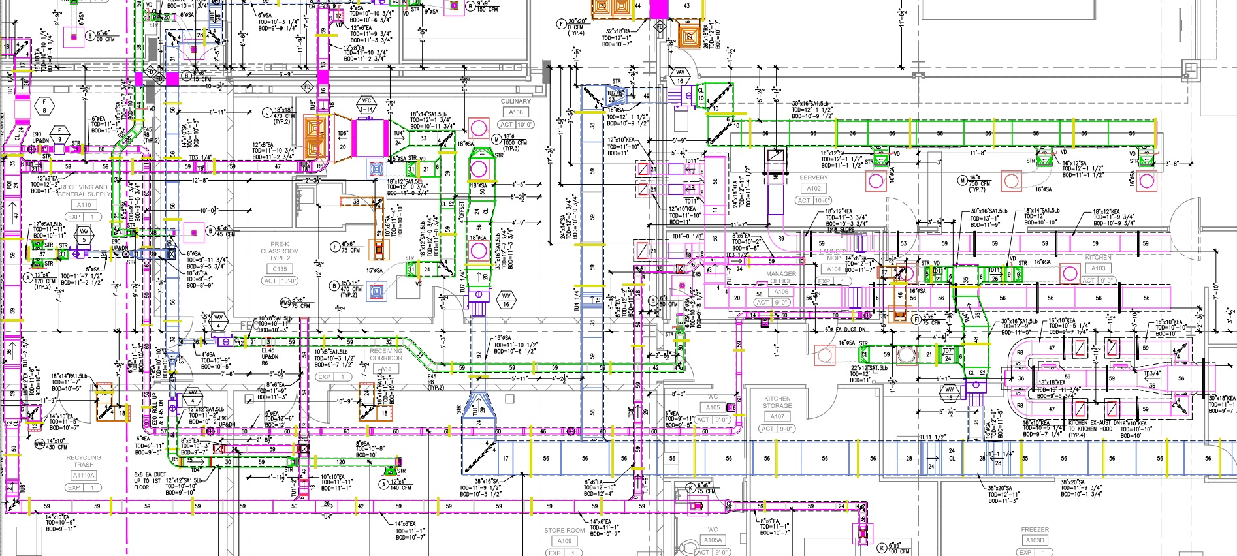
HVAC Shop Drawings

Slide 10
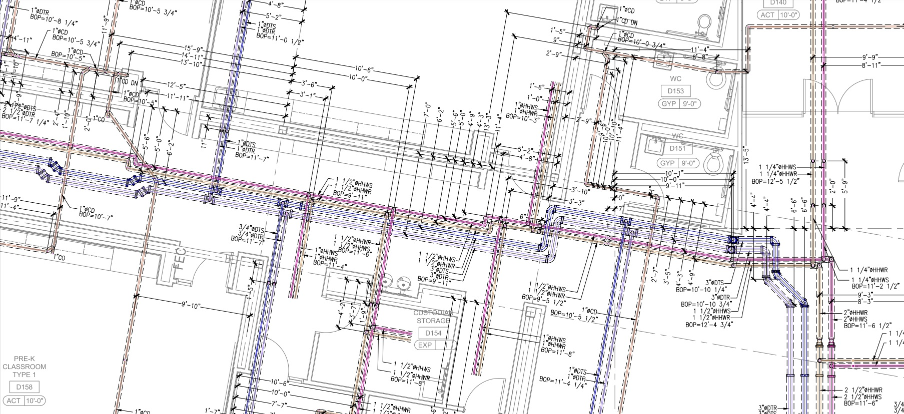
Mechanical Piping Shop Drawings

Slide 11
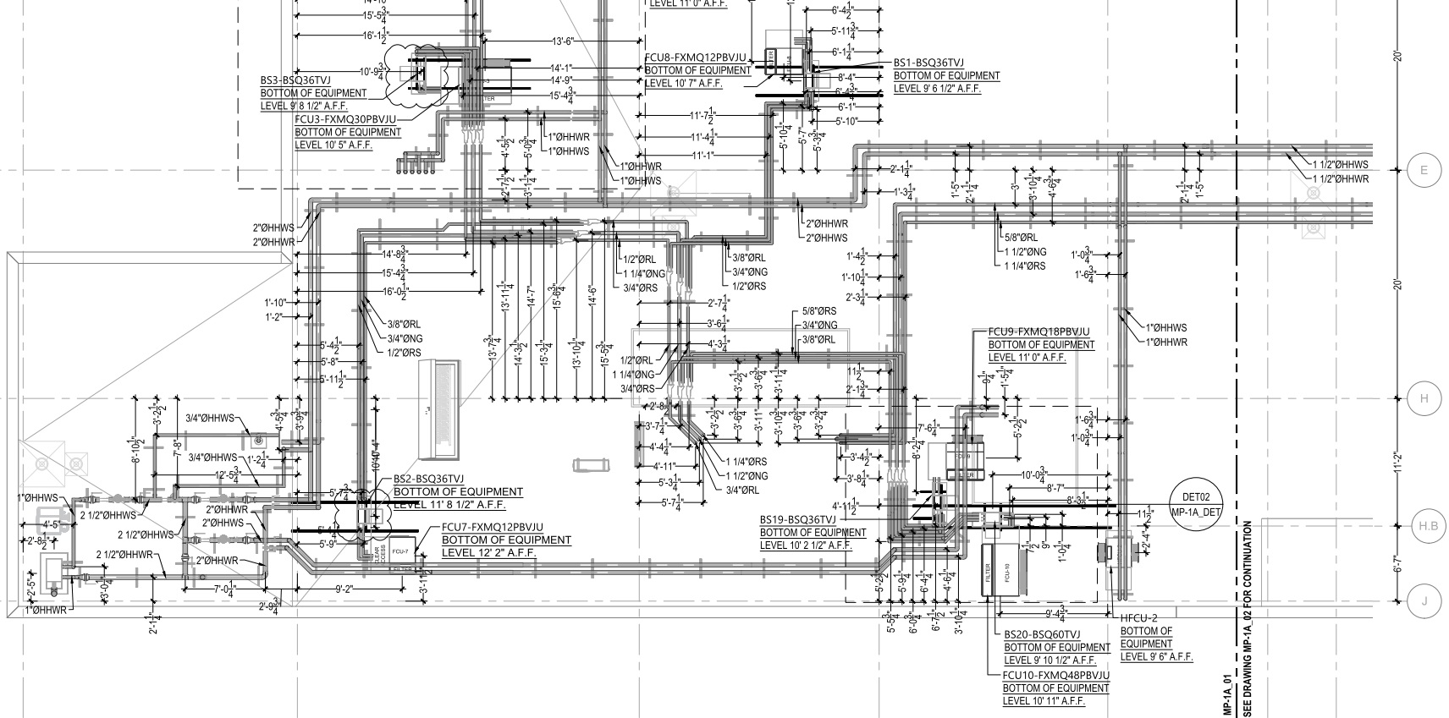
Refrigerant Piping Shop Drawings

Slide 12
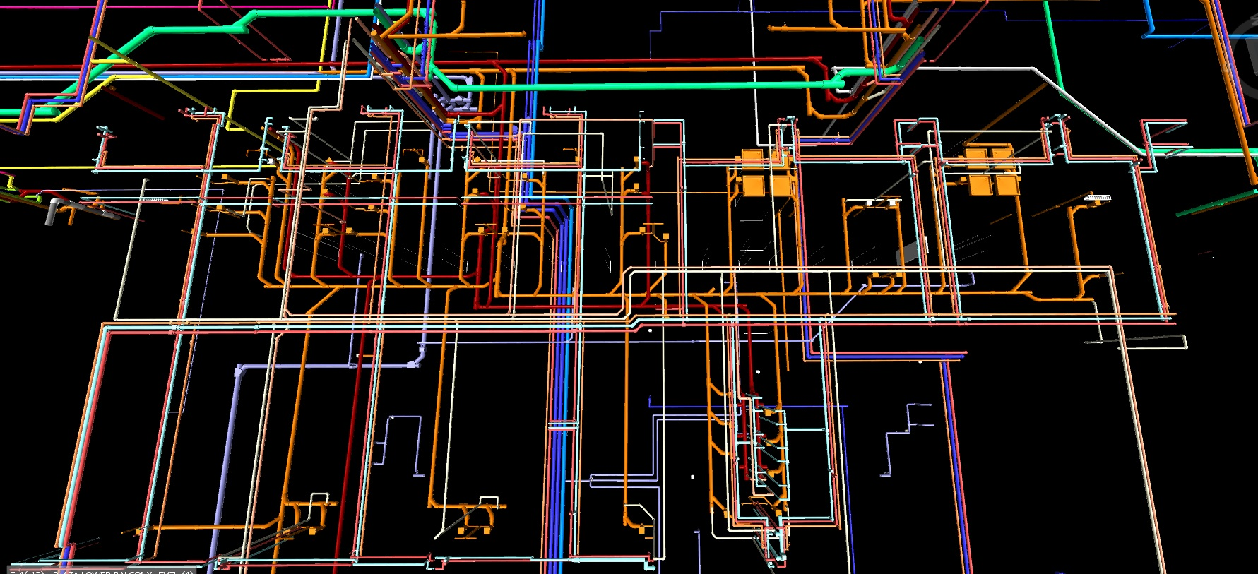
Plumbing Models
The plumbing model is created in strict compliance with contract specifications, technical submittals and the relevant codes.
We provide the Shop /Installation drawings as such they are sufficient for workshop fabrication as well as on-site installation.
We can generate accurate sleeve, penetration and hanger locations from the Plumbing model prior to the start of Plumbing installation.

Slide 13
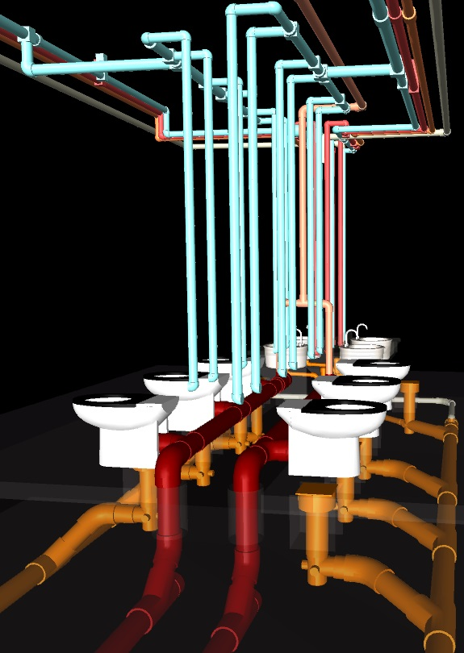
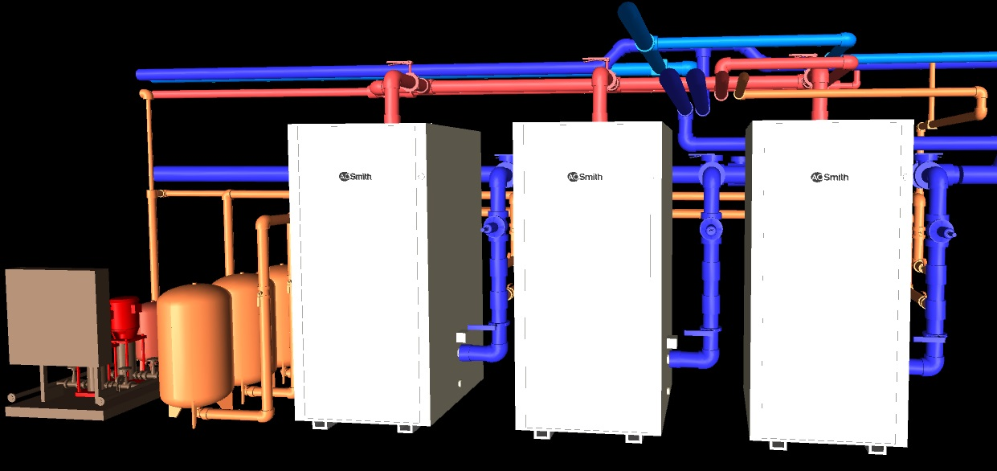
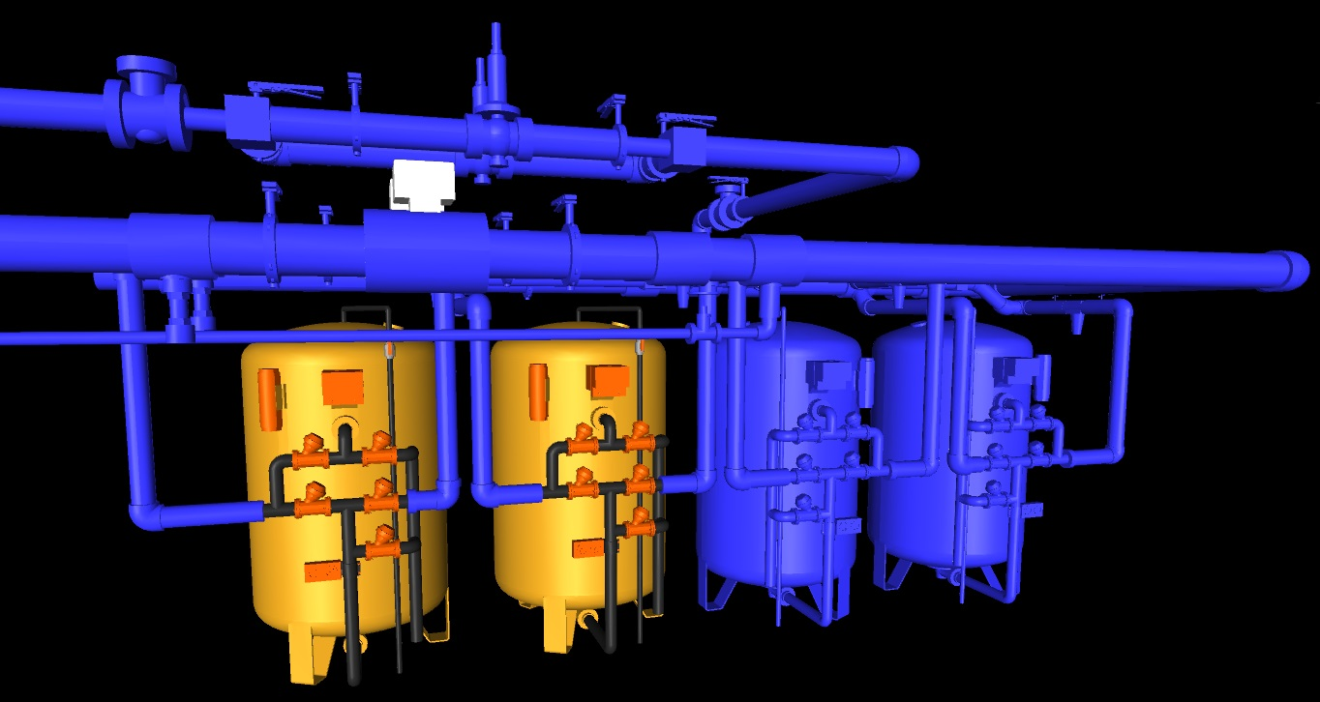
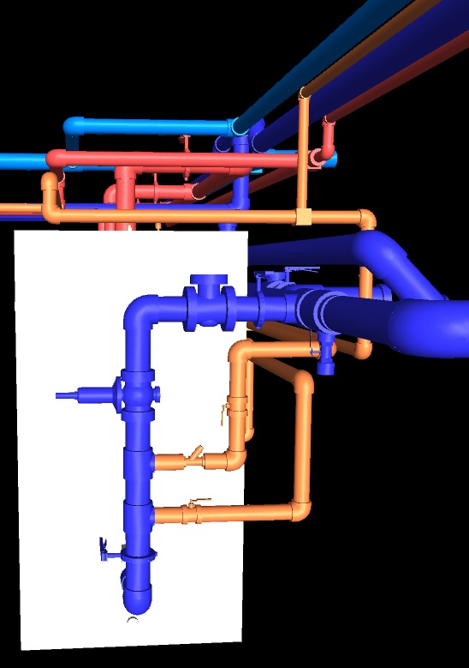
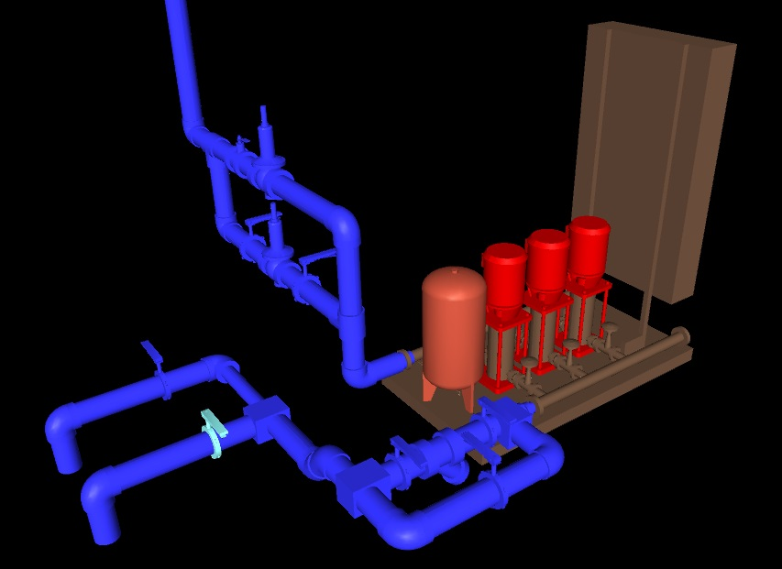
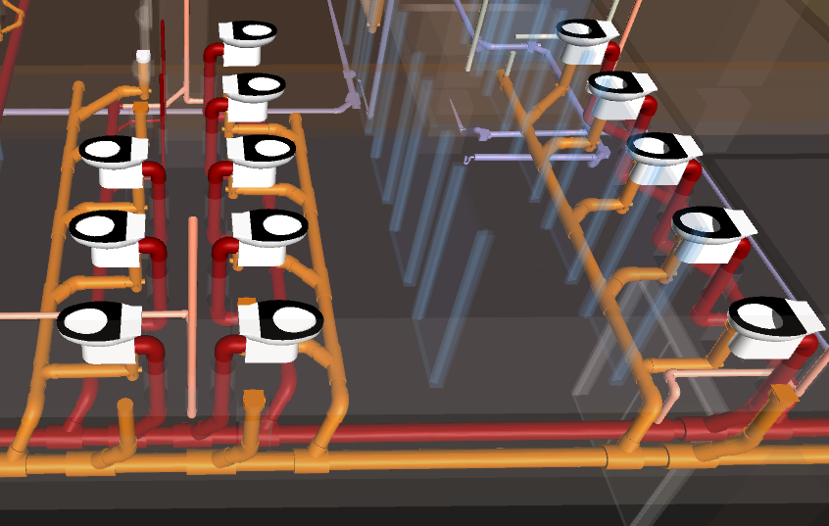
Plumbing Models

Slide 14
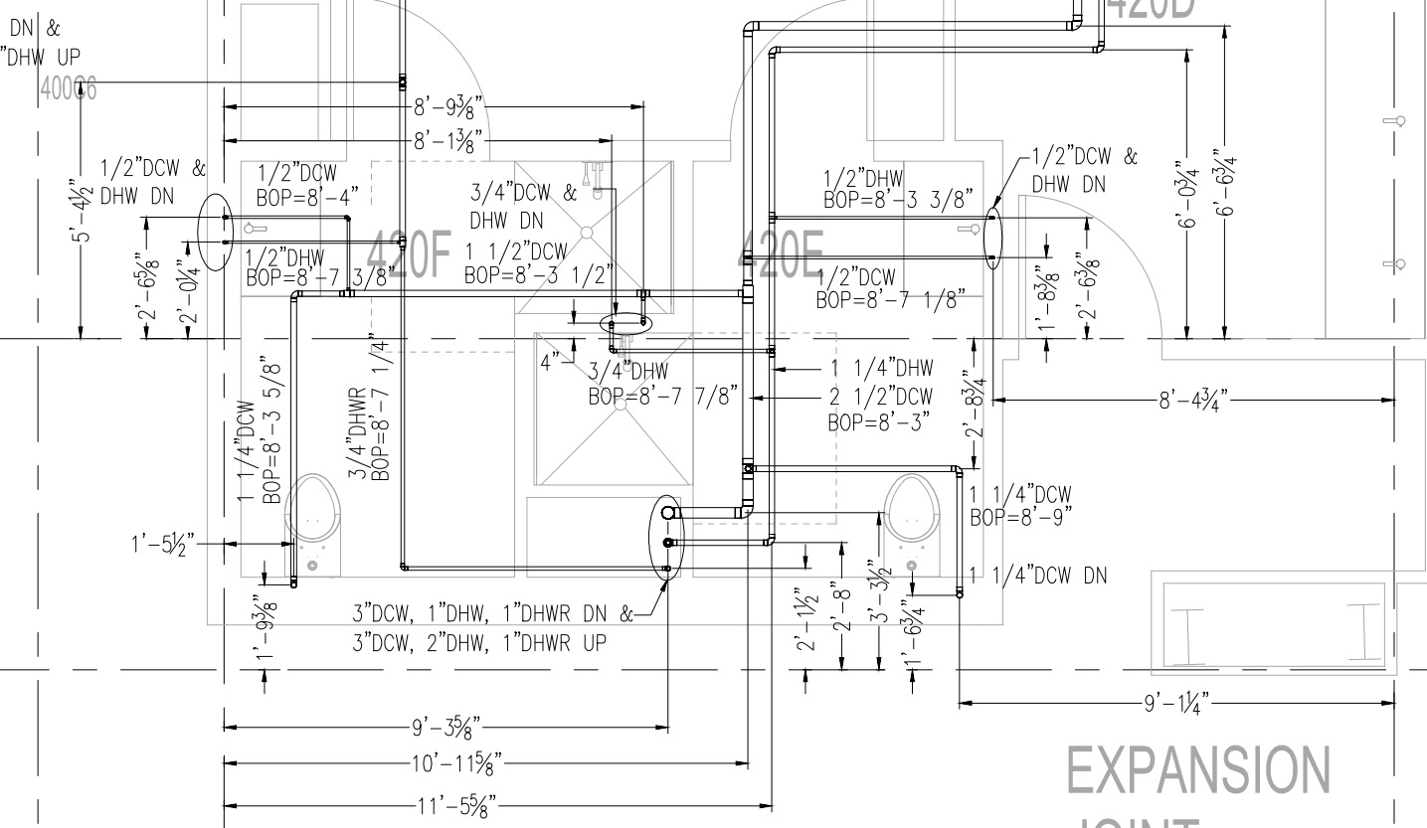
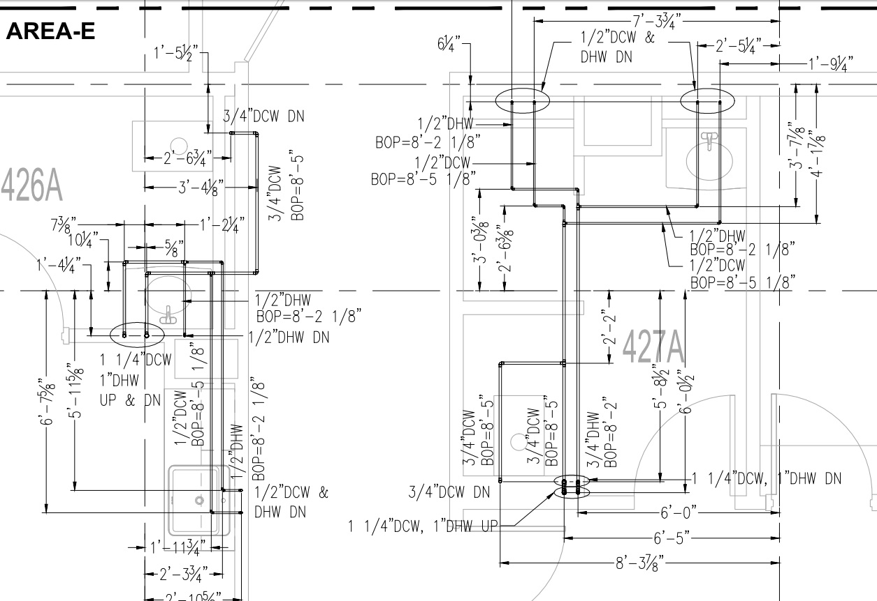
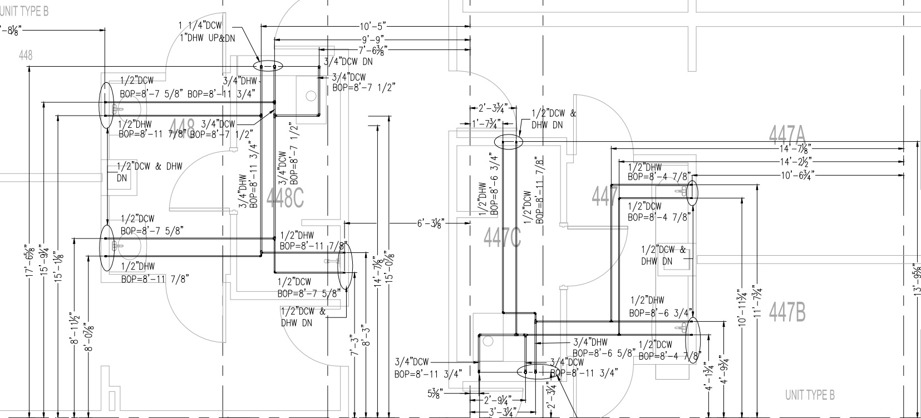
Plumbing (Domestic Water) Shop Drawings

Slide 15
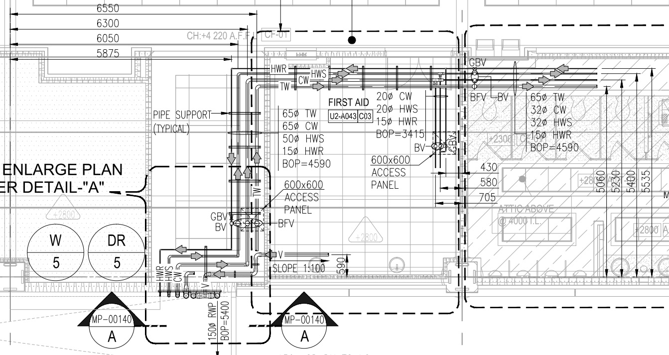
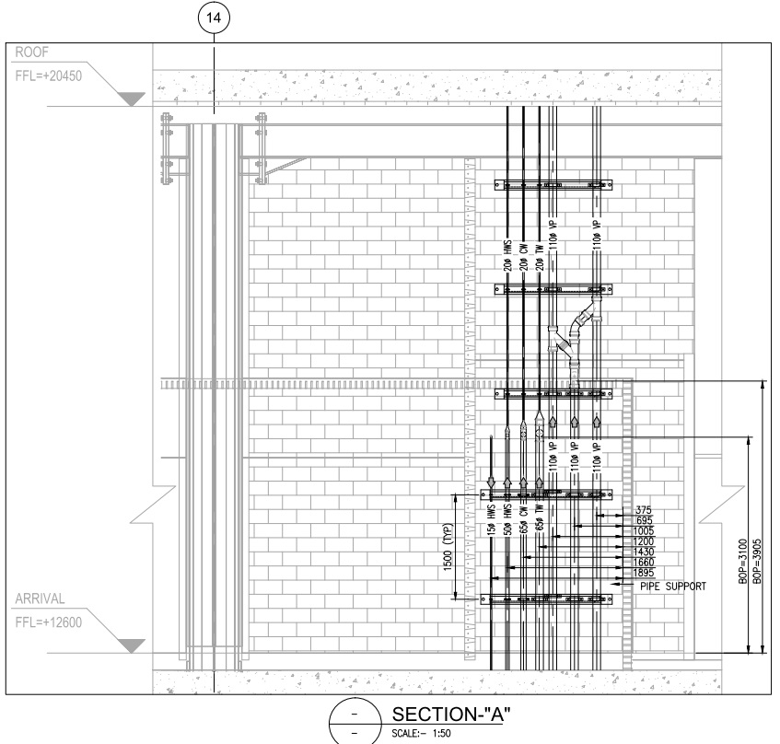
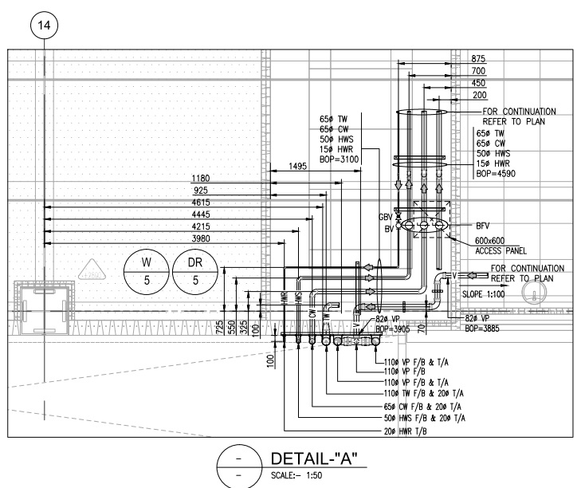
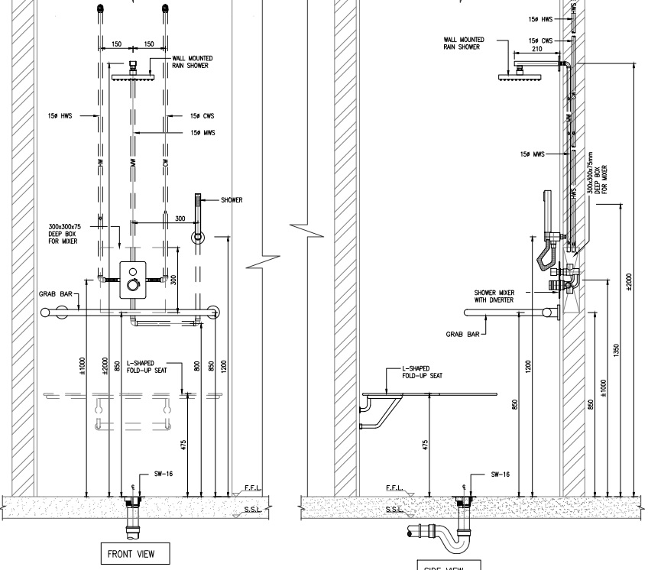
Plumbing (Domestic Water) Shop Drawings

Slide 16
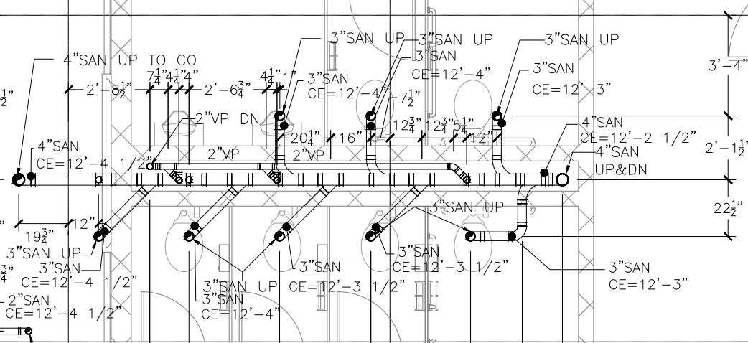
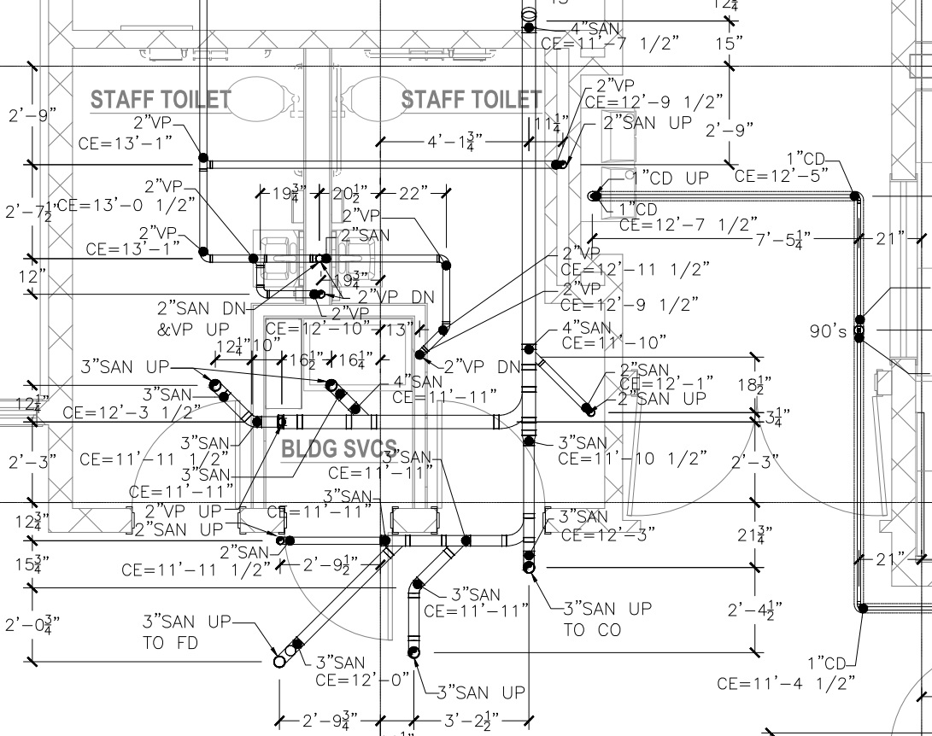
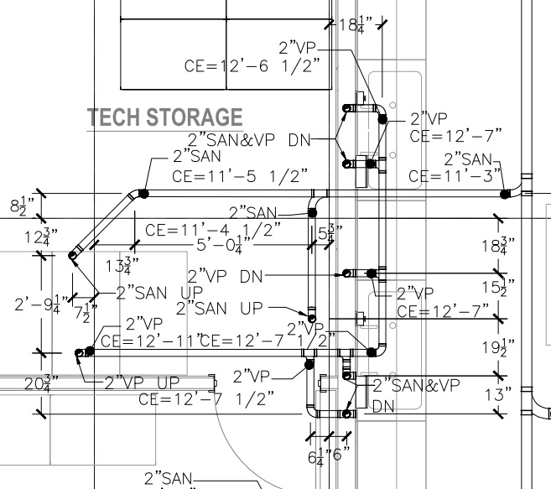
Plumbing (Drainage) Shop Drawings

Slide 17
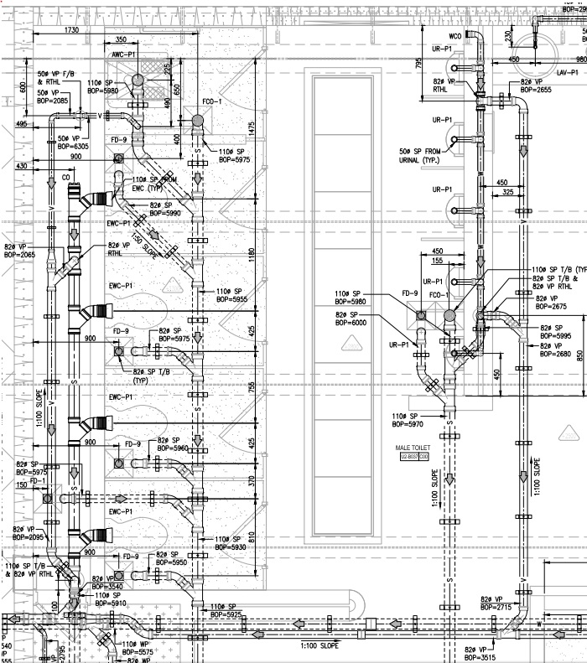
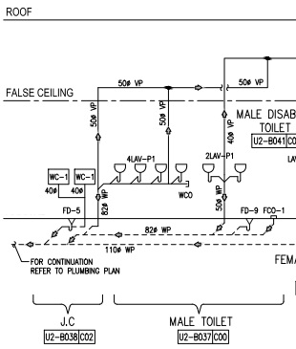
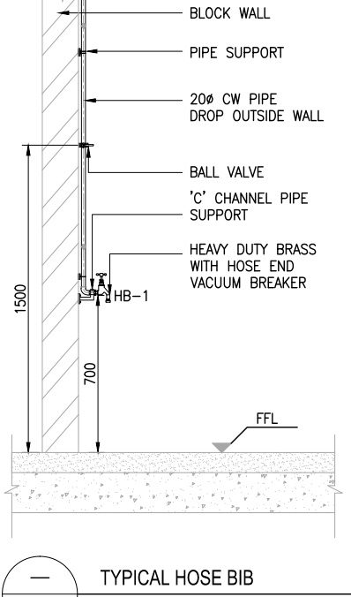
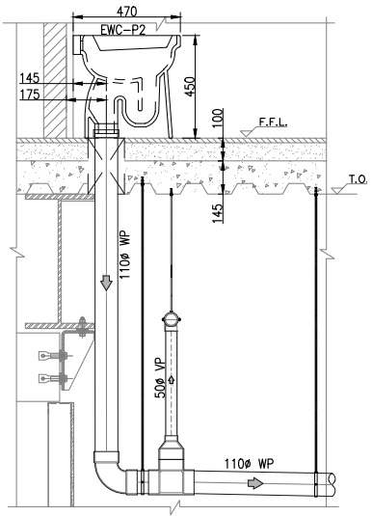
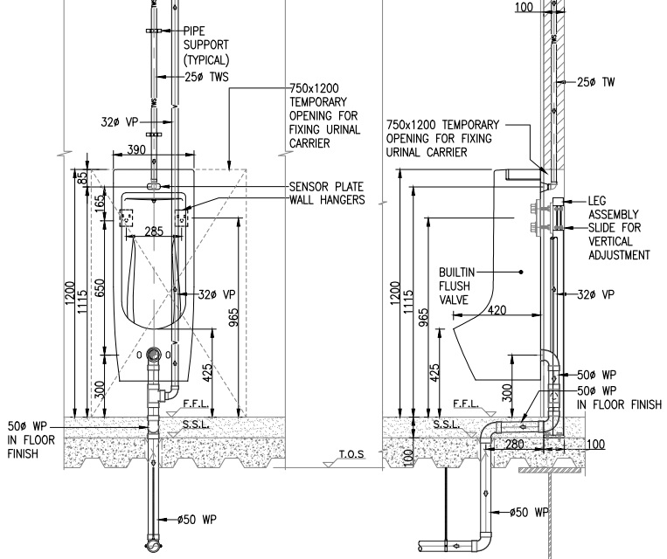
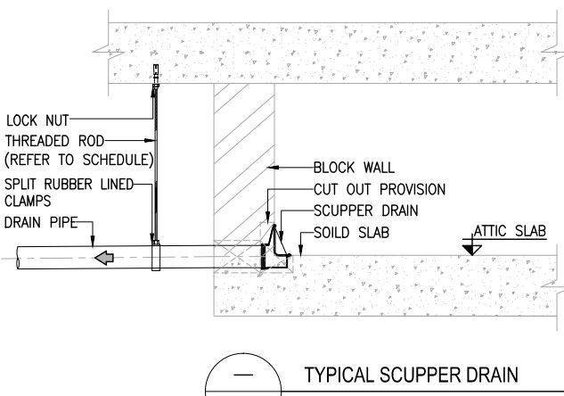
Plumbing (Drainage)Shop Drawings

Slide 18
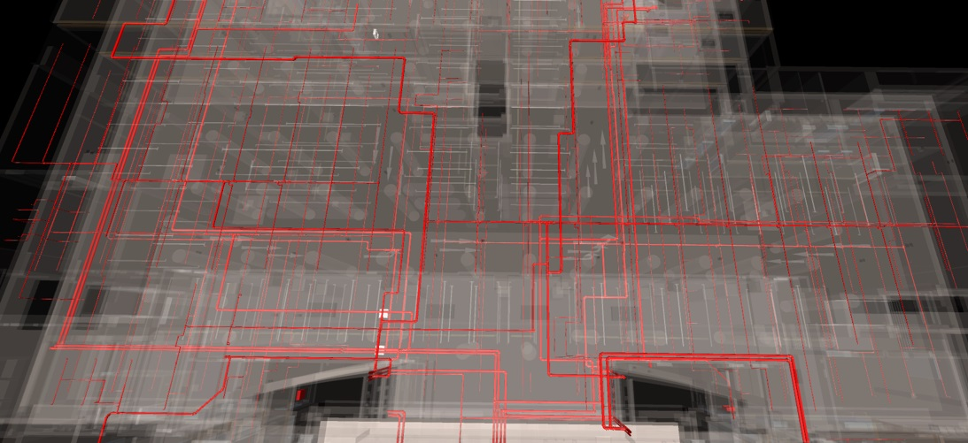
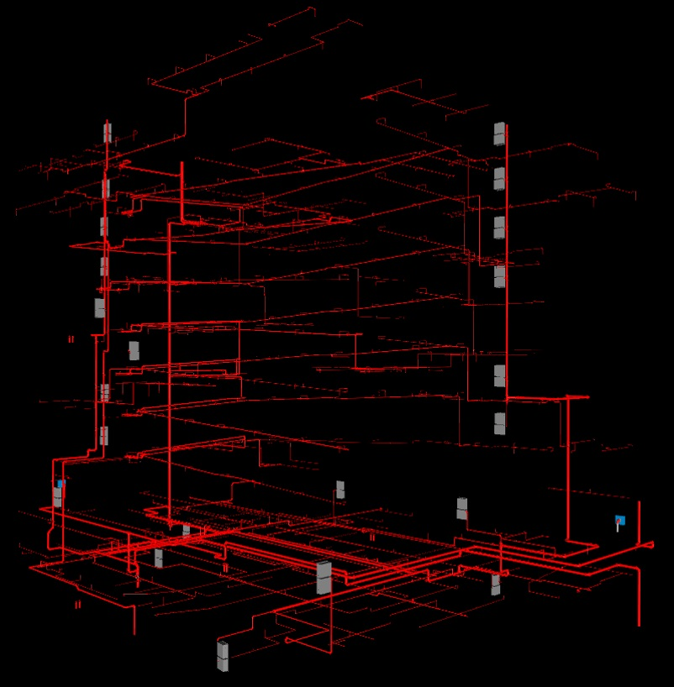
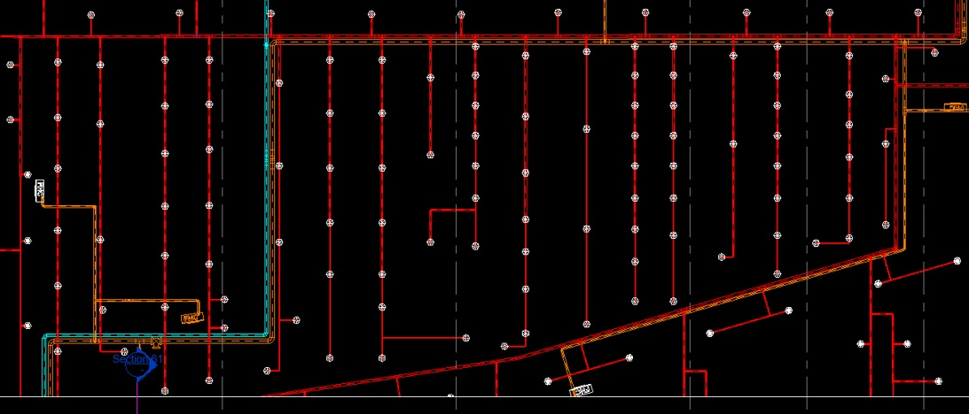
Fire Protection Models
The Fire protection model is created in strict compliance with contract specifications, technical submittals and the relevant codes NFPA & Local Fire Department of particular region the project belongs too.

Slide 19
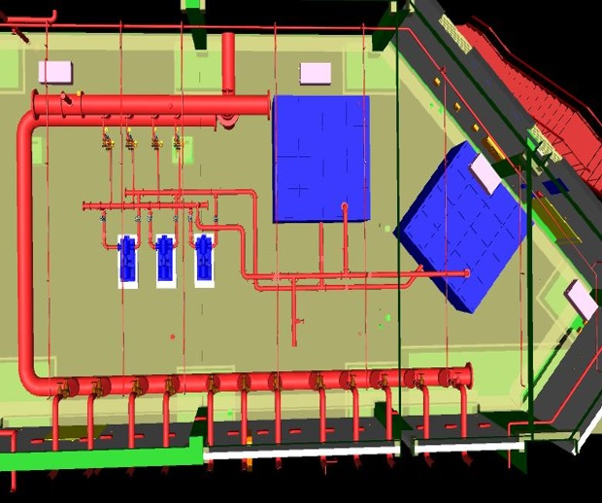
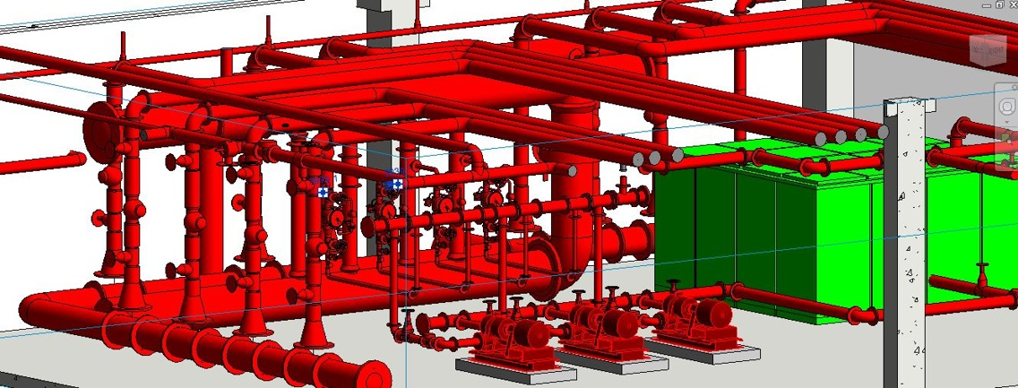
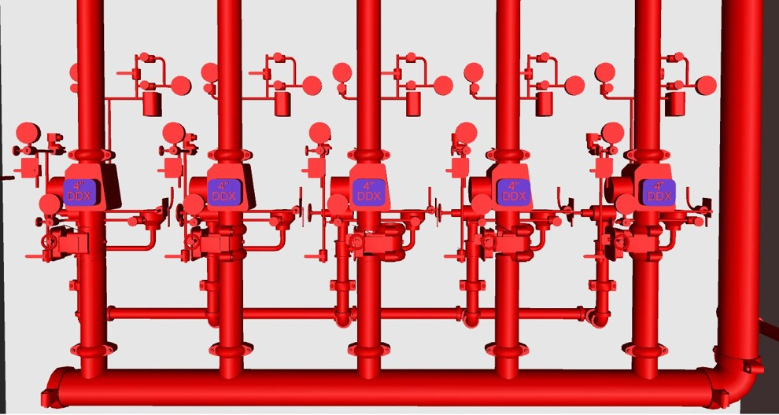
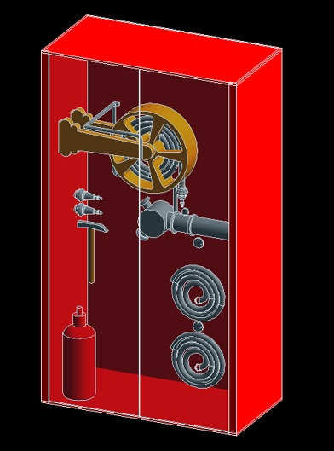
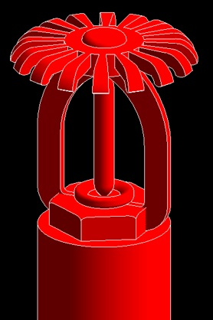
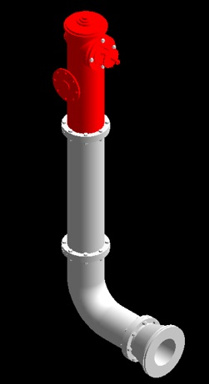
Fire Protection Model

Slide 20

Fire Protection Shop Drawing

Slide 21





Electrical Models
Electrical model of all conduits, cable tray, lighting fixtures, fire alarms and other electrical equipment from contract drawings, manufacturer cut-sheets based on client work process and standards. All the modeling will be done with strict compliance of codes of particular region the project belongs too.

Slide 22

Electrical Models

Slide 23



Electrical Models

Slide 24

Lighting Shop Drawings

Slide 25

Power Shop Drawings

Slide 26

ELV Services Shop Drawings

Slide 27

Electrical Containment Shop Drawings

Slide 28






Electrical Room Shop Drawings

Slide 29




Chemical Treatment Plant

Slide 30







Mechanical Plant room Data Centre

Slide 31



Coordination and Interference Check
The MEP model is coordinated by putting all trade together in Navisworks.
Accurate coordinated drawings help the construction team to eliminate RFI’s, rework and enables efficient construction planning.
Interference Check
Coordinated Models

Slide 32


Quantity Take-Off
The significant benefit of 3D modeling is accurate quantity information. Quantity take-off can be detailed and tabulated as per the client requirement for procurement, fabrication and installation.

Slide 33


Builders Work / Sleeve / Penetration Drawings
We provide Block out drawings on high priority as we understand the importance of providing such illustrations before pouring concrete.

Slide 34




Spool, spool map & CAM sample

Slide 35



COBIE

Slide 36



ASSET MANAGEMENT DATA

Slide 37


infrastructure & facilities
An efficient Windows based network configured with Domain controller based on Windows Server 2016 and clients with Windows 10.
HP Servers with Backup activities taken care by Veritas backup.
Data-communication links of 13Mbps and 20 Mbps leased line from different ISP’s ensures internet connectivity round the clock.
Servers are protected with dedicated UPS and the whole infrastructure is taken care by Schneider UPS system. Above all a 250 KVA Diesel Generator backup ensures us with 24 hours uninterrupted power supply.

Slide 38


data management - backup & security
We have a strong IT system in place with dedicated IT professionals to prevent loss of data and security breaches.
Dedicated firewalls (Sophos) and end point security system provides highest security for our internal network.
Data backup is maintained on daily basis at cloud server onsite and offsite locations as a measure of efficient disaster recovery.
Our Project Work-flow already defines a data backup plan, which ensures a backup is created at the end of each working day.

Slide 39





conclusion
Virtual Design Engineering Consultants
Registered Address:
H.No 22/4/624; Yakutpura;
Hyderabad – 500023
Telangana; India.
Operation's Address:
Flat no 502, 5th Floor;
Sanman PMR; Saifabad;
Hyderabad – 500004
Telangana; India.
Working Hours:
Mon – Fri 06:00 to 22:30;
Saturday & Sundays Closed
To keep seamless communication
we are available 24/7.
Phone Numbers
+1(407)309-9620
+91-8106436603
E-Mail Address:
sdas@vdengg.com
nadeem@vdengg.com
Head Office
Hyderabad

Slide 40

Mr. Shambaditya Das,
BD Manager,
Virtual Design Engineering Consultants

